Slide 1
Data Analytics
Graphing

Slide 2
Visualisation/Graphing
It is easy to create visualisations in Python using a module named matplotlib.
We need our data in a list(s) to be able to create a graph.

Slide 3
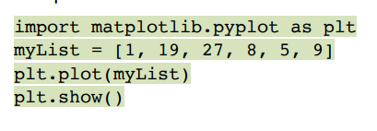
Plotting graphs
The first line uses an interface pyplot, from the matplotlib module. It is mainly used for interactive plots and simple plot generation, which is what we want.
We import as plt so that we don’t have to type matplotlib.pyplot every time we want to use it. We can just type plt instead.

Slide 4
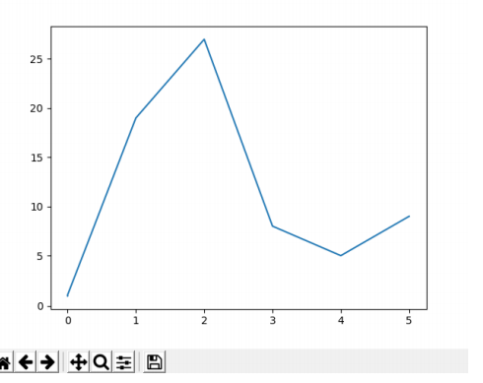
The output looks like this

Slide 5
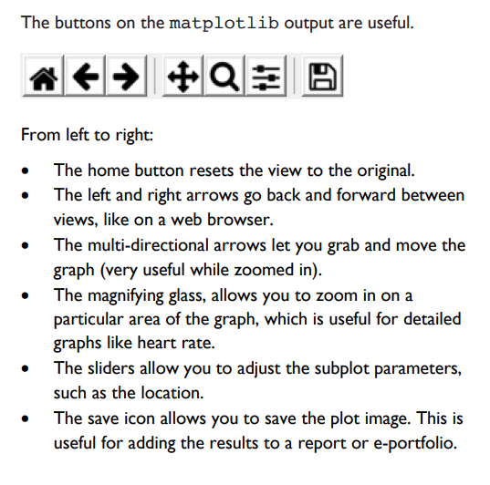

Slide 6
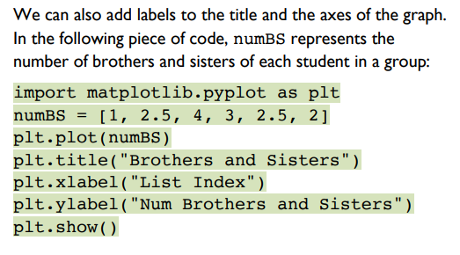
Labelling the graph

Slide 7
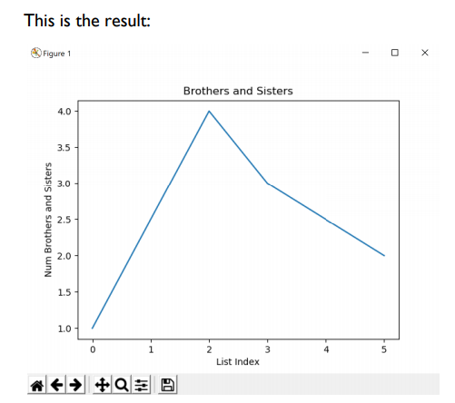

Slide 8
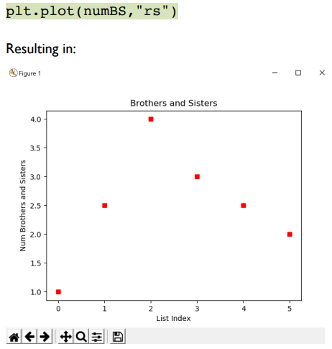
Graphing Options
A line graph may not always be suitable. For example, a line between points suggests that they are linked in some way.
The following code plots points, with no lines.

Slide 9
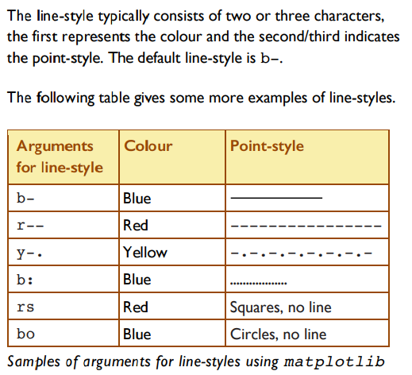

Slide 10
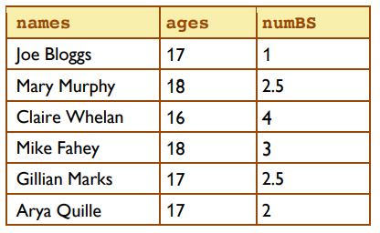
x and y axis
We can show labels on our axis.
Using the following table, we can graph the students and the number of brothers/sisters.
Note: there are two inputs so we
need two lists.

Slide 11
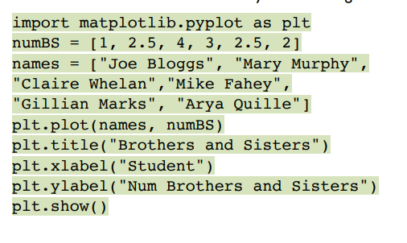
Note: The first argument represents the x-axis and the second argument represents the y-axis

Slide 12
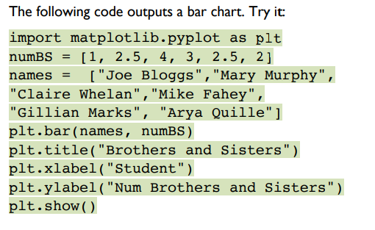
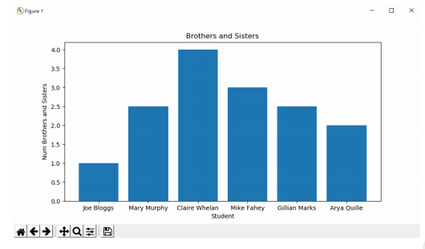
Additional plot types - Bar Chart
Bar

Slide 13
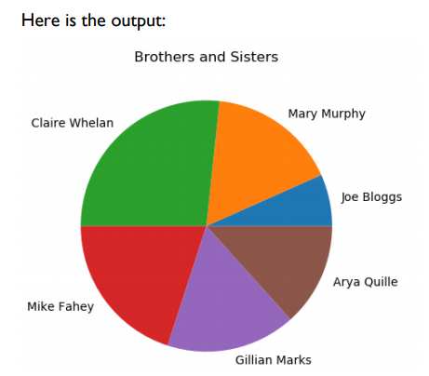
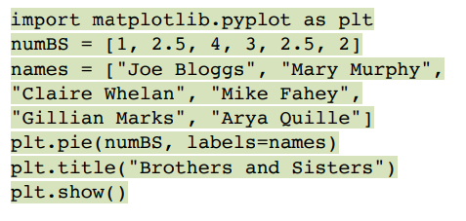
Pie Chart

Slide 14
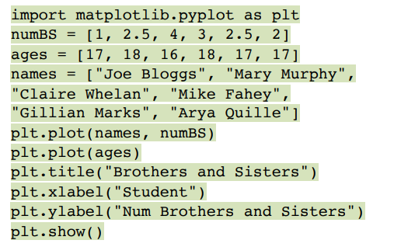
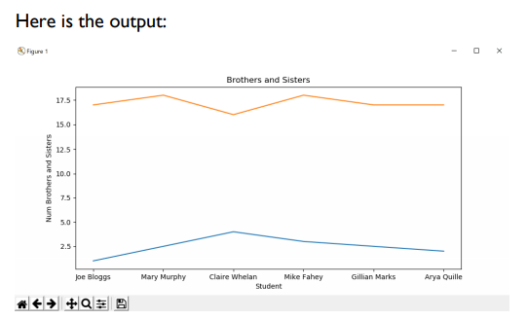
Displaying two datasets on one graph

Slide 15
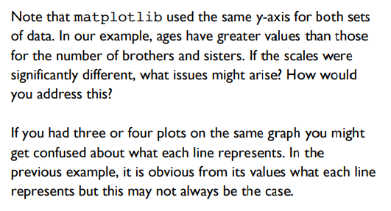

Slide 16
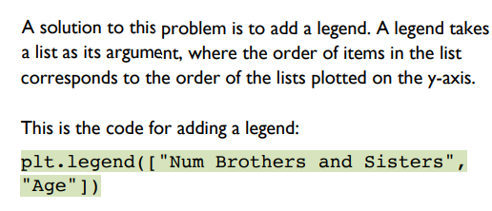

Slide 17
